Slide 1

Intergalactic Warriors
PGKPI - 2021

Slide 2
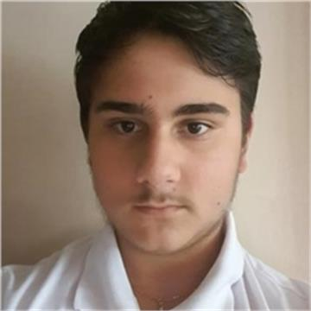



Our team
Back-end developer
Back-end developer
Back-end developer
Scrum trainer
QA engineer

Slide 3
Organization
01
Idea
02
Realization
03
Testing and improving
04
Presenting
05
.
.
.
.
.

Slide 4





Used programs

Slide 5
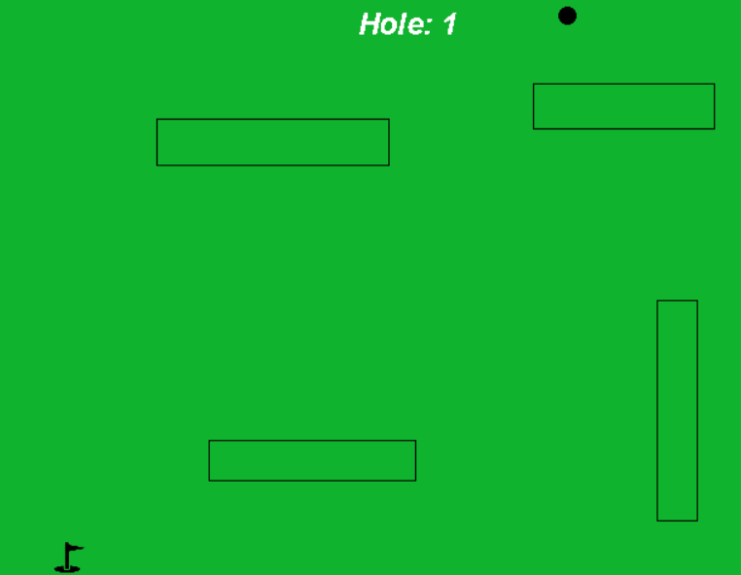
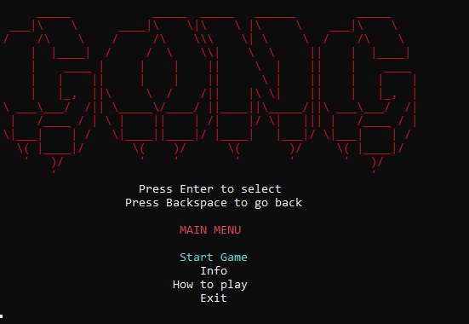
Project
.

Slide 6
Thank you for your attention!

